Slide 1
Community Foundations, Public Policy, and Levers for Action
M. Jeff Hamond
Van Scoyoc Associates
February 28, 2014

Slide 2
Status of Tax Reform
Senator Wyden (D-OR) has claimed the gavel as Senate Finance Committee Chair. He wants to move tax extenders this year and potentially mark up a package.
Ways and Means Chairman Rep. Dave Camp (R-MI) is still committed to release a framework for a complete tax overhaul, but the chasms are too big for real action this year – tax extenders is likely the only game in town. The charitable deduction is safe for now.
For long-term tax reform, what needs to give? Each side has to give up on key parts of its ideology (revenues, middle class, investment income, etc.), and we’re not quite there.
Even if “big” reform is not imminent, this doesn’t mean the sector should rest easy. The time to be active is BEFORE the crisis moment
– don’t wait to go to the ER!

Slide 3
Issues for the Charitable Sector
Obviously, the charitable tax deduction is the elephant in the room. But again, changes to the deduction will not happen this year.
There are some in Congress that are concerned about UBIT, endowments, executive compensation, and creating a “hierarchy” for charitable giving, but there are not a lot of charitable issues getting huge political attention (other than 501(c)(4)s and the like).
While most of the major players have been primarily (but not exclusively) focused on the biggest issues like the deduction, it creates an opportunity to weigh in on Tier Two and Tier Three issues. Staff are eager to hear other voices.
This creates opportunities to educate! You don’t want the first time someone hears about an issue to be during a markup.

Slide 4
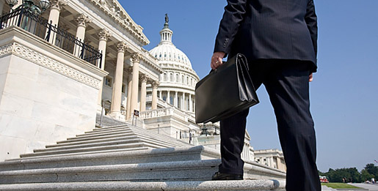
They key point here is that engagement in advance plants the seeds for success.

Slide 5
Community Foundation Outreach
How are community foundations and private foundations different?
What are the different ways that a CF engages with donors and with a local community?
What are donor-advised funds, and how is a DAF at a CF different from a DAF at a commercial gift fund like Fidelity?
What are some of the tax issues affecting community foundations (e.g., donation limits, IRA rollover, gifts of property, no payout rate for DAFs, DAF prohibition, etc.)?
STRATEGIC SHIFT: With Sen. Wyden becoming chairman, there is a real opportunity this year to repeal the DAF prohibition, and we will increasingly focus on this in the weeks and months ahead.

Slide 6
Educating Members & Their Staffs
IN-PERSON MEETINGS
106
CONFERENCE CALLS
29
Numbers based on CFPVAP activity for 2013 thru February 2014

Slide 7
Tips from a Former Staffer
Staffers like the meetings without specific asks – they like to know what’s happening in our states or districts, or in their policy areas.
Unlike many private foundations, which are national or global in their reach, your work is community focused – you are constituents! Use that to your advantage. You’re the subset of philanthropy that they should care about MOST!
While staff hear from lobbyists all the time, the call from the district is the call that will be remembered – particularly if you tell them something they don’t already know.
Last but not least: Don’t overlook the staff!

Slide 8
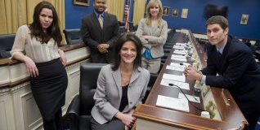
KEY TAKEAWAY: These people can be your best friends!
Although many of you might have Member-level relationships, this is not a substitute for knowing the staff.
They make more decisions than you know.

Slide 9
What Have We Learned So Far?
Most Members and staff have never had “THIS” meeting – specific to community foundations – so there is a freshness to our engagement that gets people’s attention.
Almost universally, staff reaction is a variant of “I didn’t know that” or “I hadn’t heard that before,” so we know the outreach is valuable. It creates a foundation for future asks.
After 18 months, our experience shows that this work is more important than when we started – especially since the groundwork we have laid now gives us a chance to fix something that affects all of you – the DAF prohibition.
Our effort also reinforces the notion that more voices are better than less. We HELP the Council on Foundations by engaging.
We are a key part of “Team Philanthropy.”

Slide 10
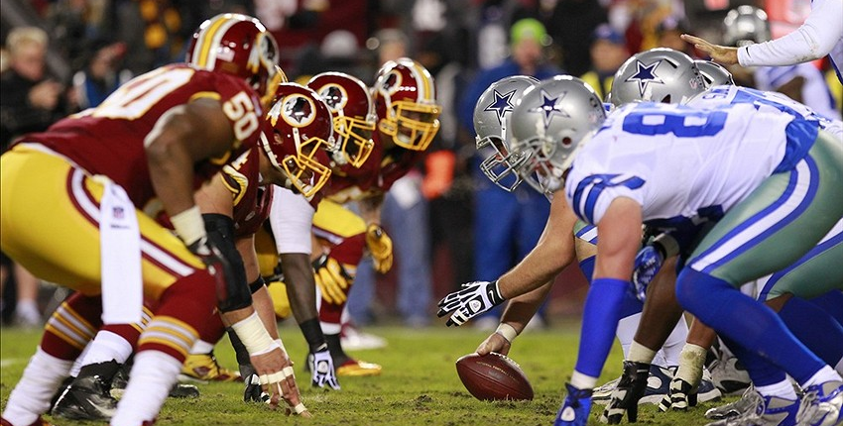
The concept of “Team Philanthropy” is important.
Think about government relations as a football defense.

Slide 11
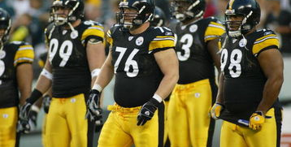
Historically, trade groups like the Council have provided the most important voice for the sector. But they aren’t the whole defense.
They represent the defensive line.
Big. Important. Necessary. The first line of defense.
With lots of members, however, they can’t always react quickly.

Slide 12
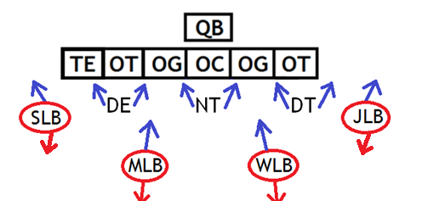
But a good football defense can’t rely just on the defensive line.
It also needs excellent linebackers.
What do linebackers bring? Quickness and versatility.
They can be aggressive and blitz the quarterback.
They can stay put and defend the run.
They can drop back into pass defense.

Slide 13
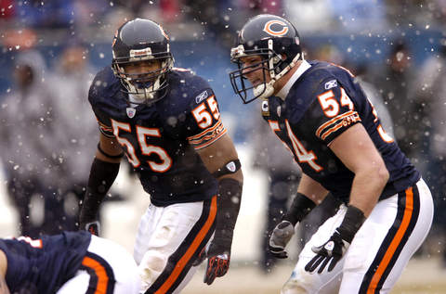
What could be the Philanthropy Team’s linebackers?
A regional association of grantmakers
An affinity group of foundations that all invest in a certain policy area (e.g., Grantmakers for Education)
Smaller membership groups like the Association of Small Foundations (ASF)

Slide 14
The problem is that few of these “linebackers” actually engage in direct advocacy. So the work of the sector is not as well understood as it could be.
As community foundations, collectively you represent a potentially powerful linebacker. You can be flexible, innovative, and responsive in a way that the defensive line can’t.
You are not a substitute for the line. The philanthropy sector needs both. Just as strong play from its linebackers bolsters a defense, so too do your collective efforts help the sector as a whole.

Slide 15
SO IS THIS ALL THAT
COMMUNITY FOUNDATIONS NEED
TO BE SUCCESSFUL?
NO!
A good football defense has a solid line, dependable linebackers, and also something else…

Slide 16
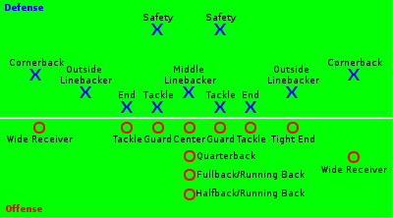
Any successful defense must also have a quality secondary.
Defensive backs are fast and nimble.
They can react in real time to issues as they develop.
They are the last line of defense.

Slide 17
The secondary in this case is all of YOU.
YOUR calls and e-mails to Members and staff.
YOUR engagement with local, state, and federal officials.
YOUR efforts to change public policy.

Slide 18
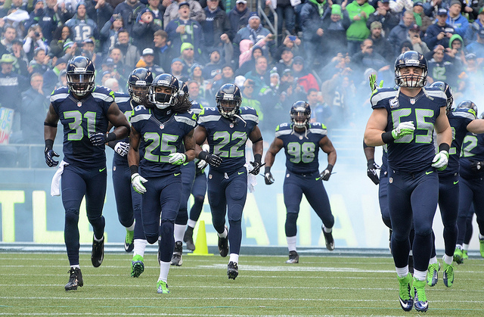
When the defensive line, the linebackers, and the secondary ALL work together, the result is a championship team.

