Slide 2
Greater Cleveland University Circle Initiative (GUCI) Introductory Video

Slide 3
Green City Growers Cooperative

Slide 4
GUCI Neighborhoods

Slide 5
Vacancy, Poverty and Disconnection

Slide 6
Cleveland High Poverty Neighborhoods
Households with Income of $25,000 or Less
Central | 78 | %
University Circle | 62 | %
Hough | 61 | %
Fairfax | 58 | %
Glenville | 56 | %
East Cleveland | 56 | %
Buckeye-Shaker | 49 | %
Total | 58 | %
City of Cleveland | 46 | %
Cuyahoga County | 30 | %
Notes:
Poverty in Greater University Circle neighborhoods continues, while rates are also high in Cleveland and Cuyahoga County (Case Western Reserve University).
“Greater Cleveland continues to shed more jobs than any big city metro area in the nation. Since May, the Cleveland-Elyria-Mentor metro area has lost more jobs than any large metro area in the country” - Cleveland Plain Dealer, December 2013
Cleveland Metro area leads the nation in job loss six months running.

Slide 7
GUCI Timeline
2003-2006
TCF staff restructuring – New ideas, high performing practitioners, strong community networks
2005-2008
2008-2011
New three-year goals identified
2011-2013
GUCI established
First GUCI Leadership meeting
Priority physical development and transportation projects identified
Housing and economic inclusion initiatives launched
Launch of Greater Circle Living, Health Tech Corridor, NewBridge Cleveland Center for the Arts, Neighborhood Voice
Opened two Evergreen companies
New three year goals
Launch of community engagement strategy through neighborhood connections
Third Evergreen company opened
Physical development projects are fully financed, transit projects break ground, and private development projects complete construction (i.e. MOCA and Uptown)

Slide 8
GUCI Strategies
1) Institutional Partnership
2) Physical Development
3) Economic Inclusion (Programs for People)
4) Community Engagement
(Connect)
Buy Local
Live Local
Hire Local
*Economic Inclusion sub-strategies

Slide 9
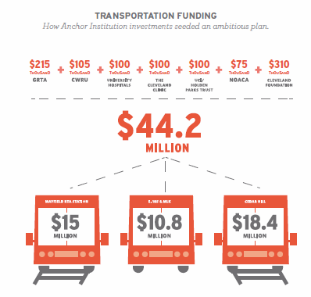
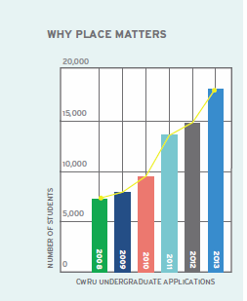
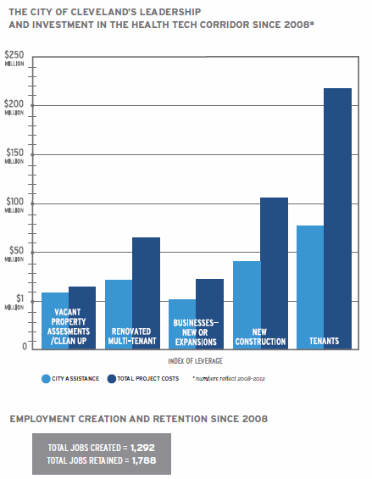
GUCI Outcomes
1) Leadership
First-ever GUCI Leadership Table
2) Physical Development
More than $140 million or public and private financing leveraged by local investments
3) Economic Development
- A Local procurement program - Three worker-cooperative businesses - A workforce training center
4) Community Engagement
A comprehensive, asset-based resident engagement strategy building upon the power of networks

Slide 10
Why GUCI Matters
Demonstrates the power of anchor-led community reinvestment strategies
Demonstrates the power and potential of collaborative leadership
Demonstrates the power of local philanthropy to serve as a catalyst for scalable community change

Slide 11
GUCI Lessons #1
Planning and Guiding a Dialogue for Change
Create a forum for in-depth dialogue among anchor institutions.
Invest in relationship building.
Minimize outside pressure on any individual institution.
Identify a “neutral convener.”
Engage anchor institution staff at all levels.

Slide 12
GUCI Lessons #2
Defining Programs and Scope
Define geographic boundaries.
Engage local and international experts.
Include people-focused programs.
Allow programs to pivot and evolve when reacting to external factors.
Protect the initiative from changes in institutional and political leadership.

Slide 13
GUCI Lessons #3
Building Support and Spreading the Word
Center strategies around a shared vision.
Seek visibility from within and outside the local community.
Emphasize the importance of place, local economies, and people to anchor institutions.
Encourage and expect co-investment.

Slide 14
Thank You

